Slide 1
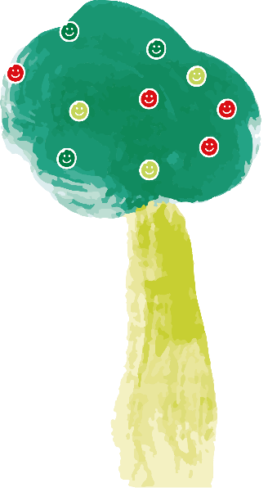
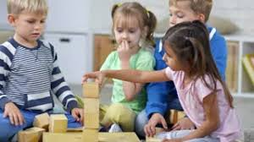
Warm up activity Think of a time when you have helped someone
How did you feel after?
How do you think it made them feel?
When might you need help?
Why did you help?
How did you help?

Slide 2
An introduction to Children’s Hospice South West (CHSW)
CHSW helps families make the most of short and precious lives.
They do this by looking after children that have life–limiting conditions. This means that the children may die before reaching adulthood because of an illness that they’ve developed or genetic condition they were born with.
When families go to stay at one of their hospices for a short break, CHSW take on the day to day care and provide the medicine needed for these children. This means that families can relax and enjoy special time together without the responsibilities they would normally have as full time carers and instead they can just have fun and make precious, happy memories.
They can do things they couldn't at home because CHSW are there to support them in everyway. They help everyone in the child’s family: mums and dads, brothers and sisters. CHSW offer a ‘home from home’ and become part of their lives for many years.

Slide 3
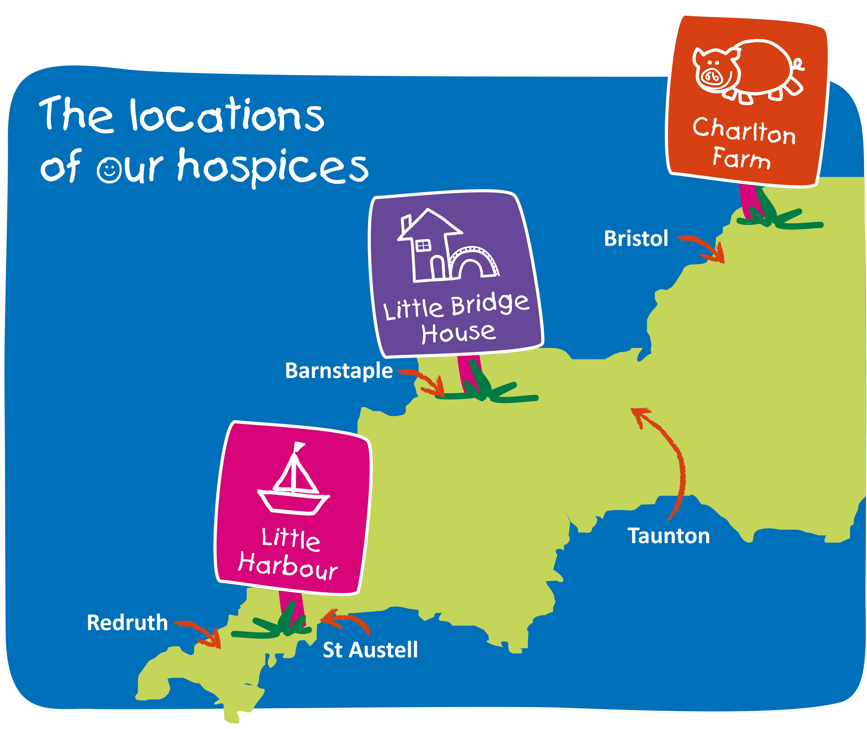
ur Hospices
Children’s Hospice South West have three hospices across the South West.

Slide 4
Understanding the connections
CHSW works together within their charity to reach their fundraising goals, but they also have help from volunteers. Without volunteers, they could not do all the work needed to help the families that they care for.
Today, you can help us by taking part in fun activities that help us to work together

Slide 5
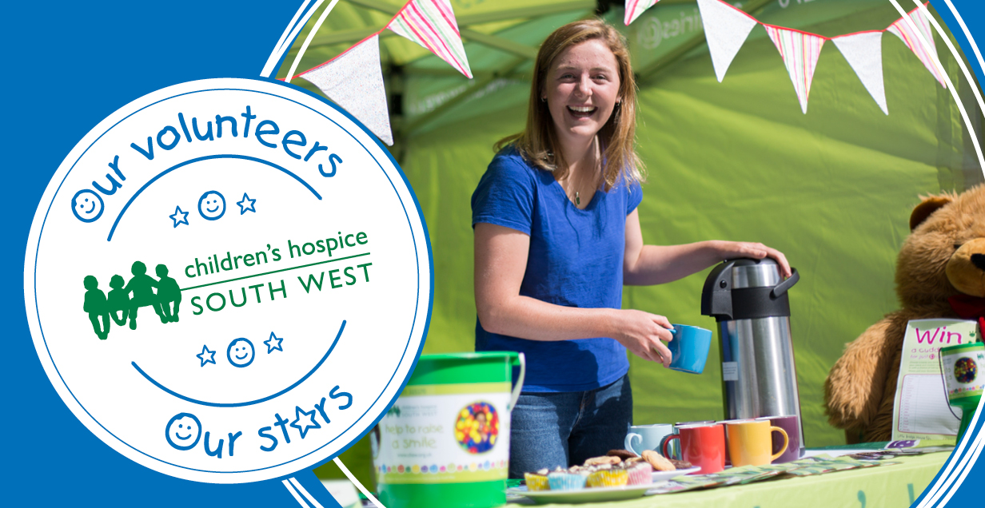
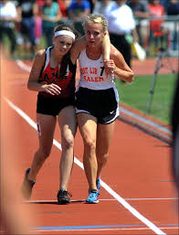
Activity

Slide 6
Discussion Time!
Why is it important to help people?
Why is it good to help people?
Why is it good to give your time to others?
How is working together part of the CHSW?
for learning about Children’s Hospice South West!

