Slide 1
Desert Island Supplies… How would you survive?
Imagine you’re on a desert island.
What are the top 5 things that you would take with you?
How practical have you been?
Why are your choices more important or better than anyone else’s?

Slide 2
An introduction to Children’s Hospice South West (CHSW)
CHSW helps families make the most of short and precious lives.
They do this by looking after children that have life–limiting conditions. This means that the children may die before reaching adulthood because of an illness that they’ve developed or genetic condition they were born with.
When families go to stay at one of their hospices for a short break, CHSW take on the day to day care and provide the medicine needed for these children. This means that families can relax and enjoy special time together without the responsibilities they would normally have as full time carers and instead they can just have fun and make precious, happy memories.
They can do things they couldn't at home because CHSW are there to support them in everyway. They help everyone in the child’s family: mums and dads, brothers and sisters. CHSW offer a ‘home from home’ and become part of their lives for many years.

Slide 3
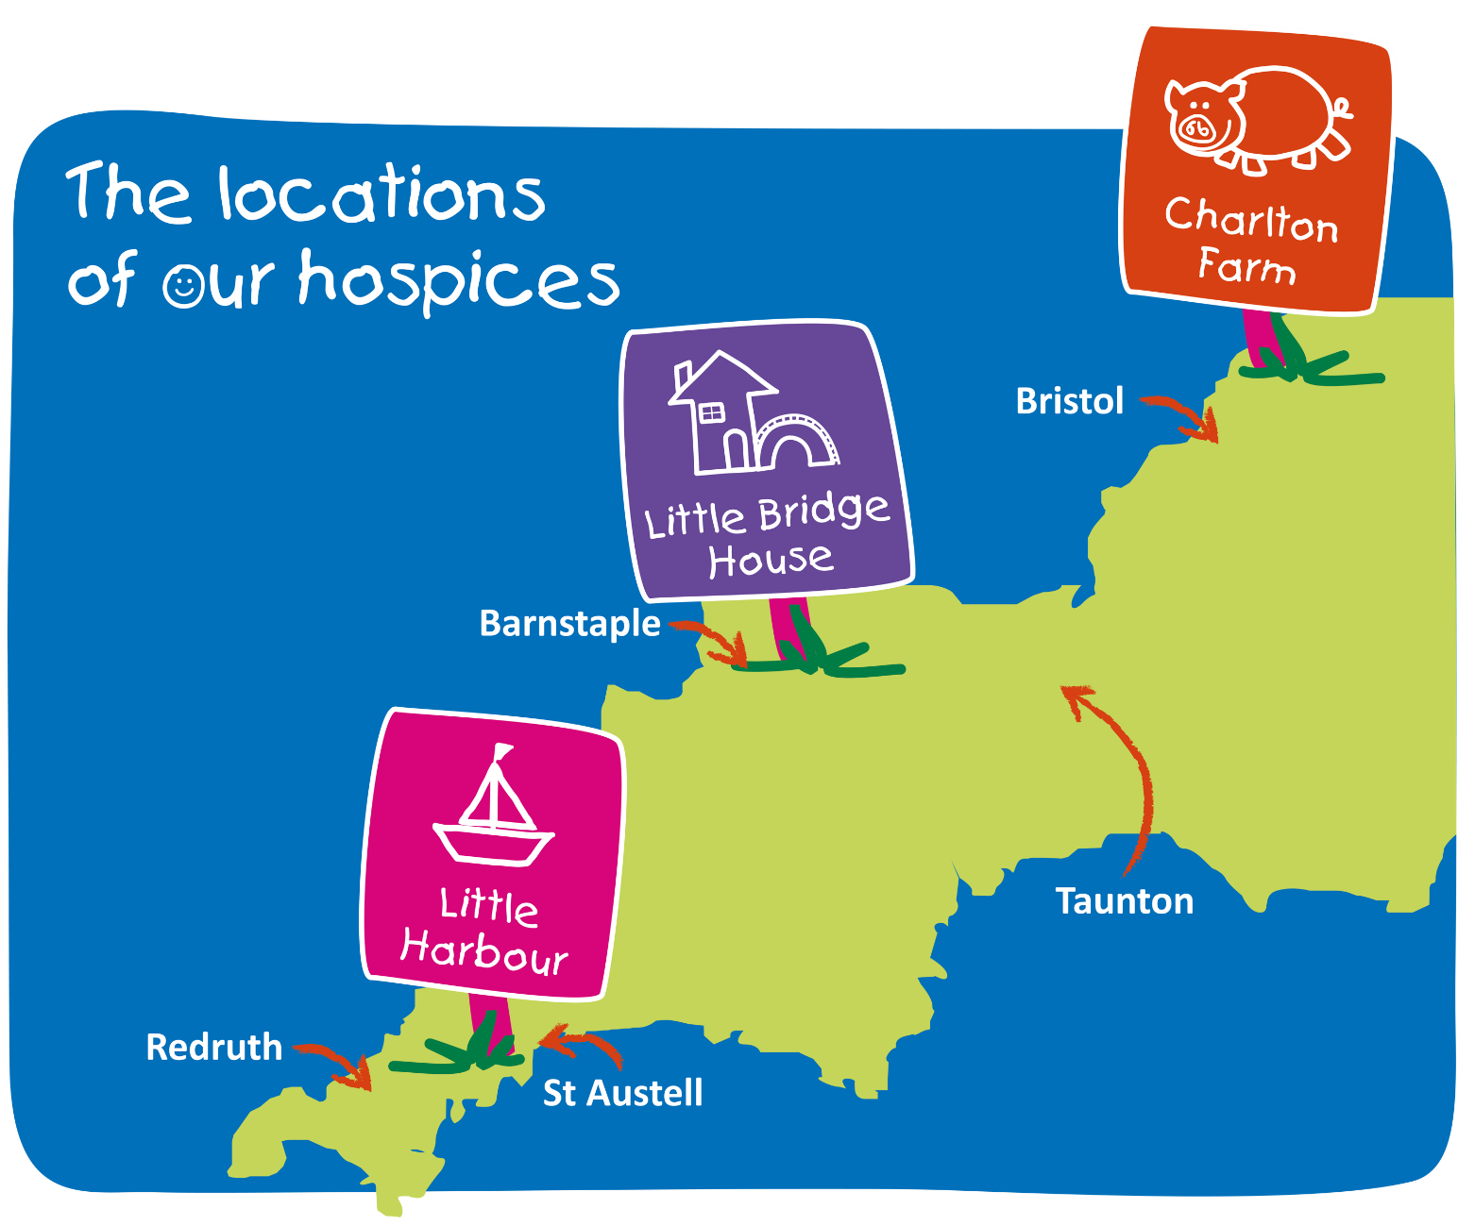
ur Hospices
Children’s Hospice South West have three hospices across the South West.

Slide 4
Understanding the connections
People complete challenges and push
themselves to do extraordinary things for Children’s Hospice South West. They are motivated by their compassion and empathy which moves them to want to help the children in our care. However, some of the greatest challenges are the ones faced by the children themselves and we are all inspired by their strength.
Today, you can help us by thinking about ways to inspire others to overcome challenges and push themselves!

Slide 5
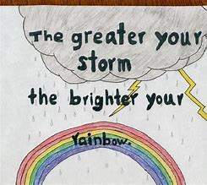
Activity
We are going to design posters to inspire others and encourage them to accomplish goals, overcome challenges and push themselves to achieve.
What positive phrases or slogans can we think of?
What sort of images are inspirational?
What is the aim of your poster?

Slide 6
Let’s look at each other’s posters!
Which ones did you find the most inspirational and why?
Have you been encouraged to face a new challenge?
Have you based your poster on challenges that you have faced and overcome?
for learning about Children’s Hospice South West!

